Slide 1

IBM-nasscom Virtual Internship Program
Project Presentation
Marks And Placement Prediction Project
By : Aditya
Batch:4
Ph:7048948429
E-mail:adityakr182005@gmail.com

Slide 2
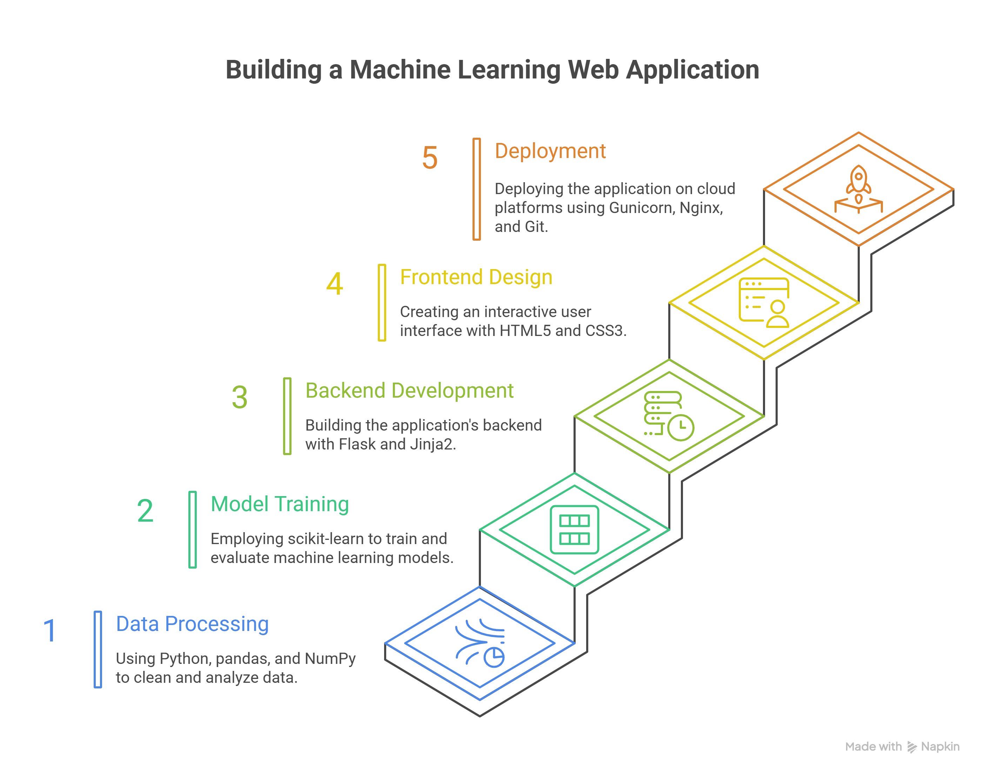
Problem Statement Educational institutions face challenges in predicting student performance and placement outcomes. Without a systematic model, it is difficult to identify at-risk students, provide targeted guidance, and allocate resources effectively. This project develops a machine learning–based system that uses academic indicators (e.g., CGPA, IQ, marks) to predict both student performance and placement likelihood. The goal is to support better decision-making, improve placement rates, and offer actionable insights for students and faculty.

Slide 3
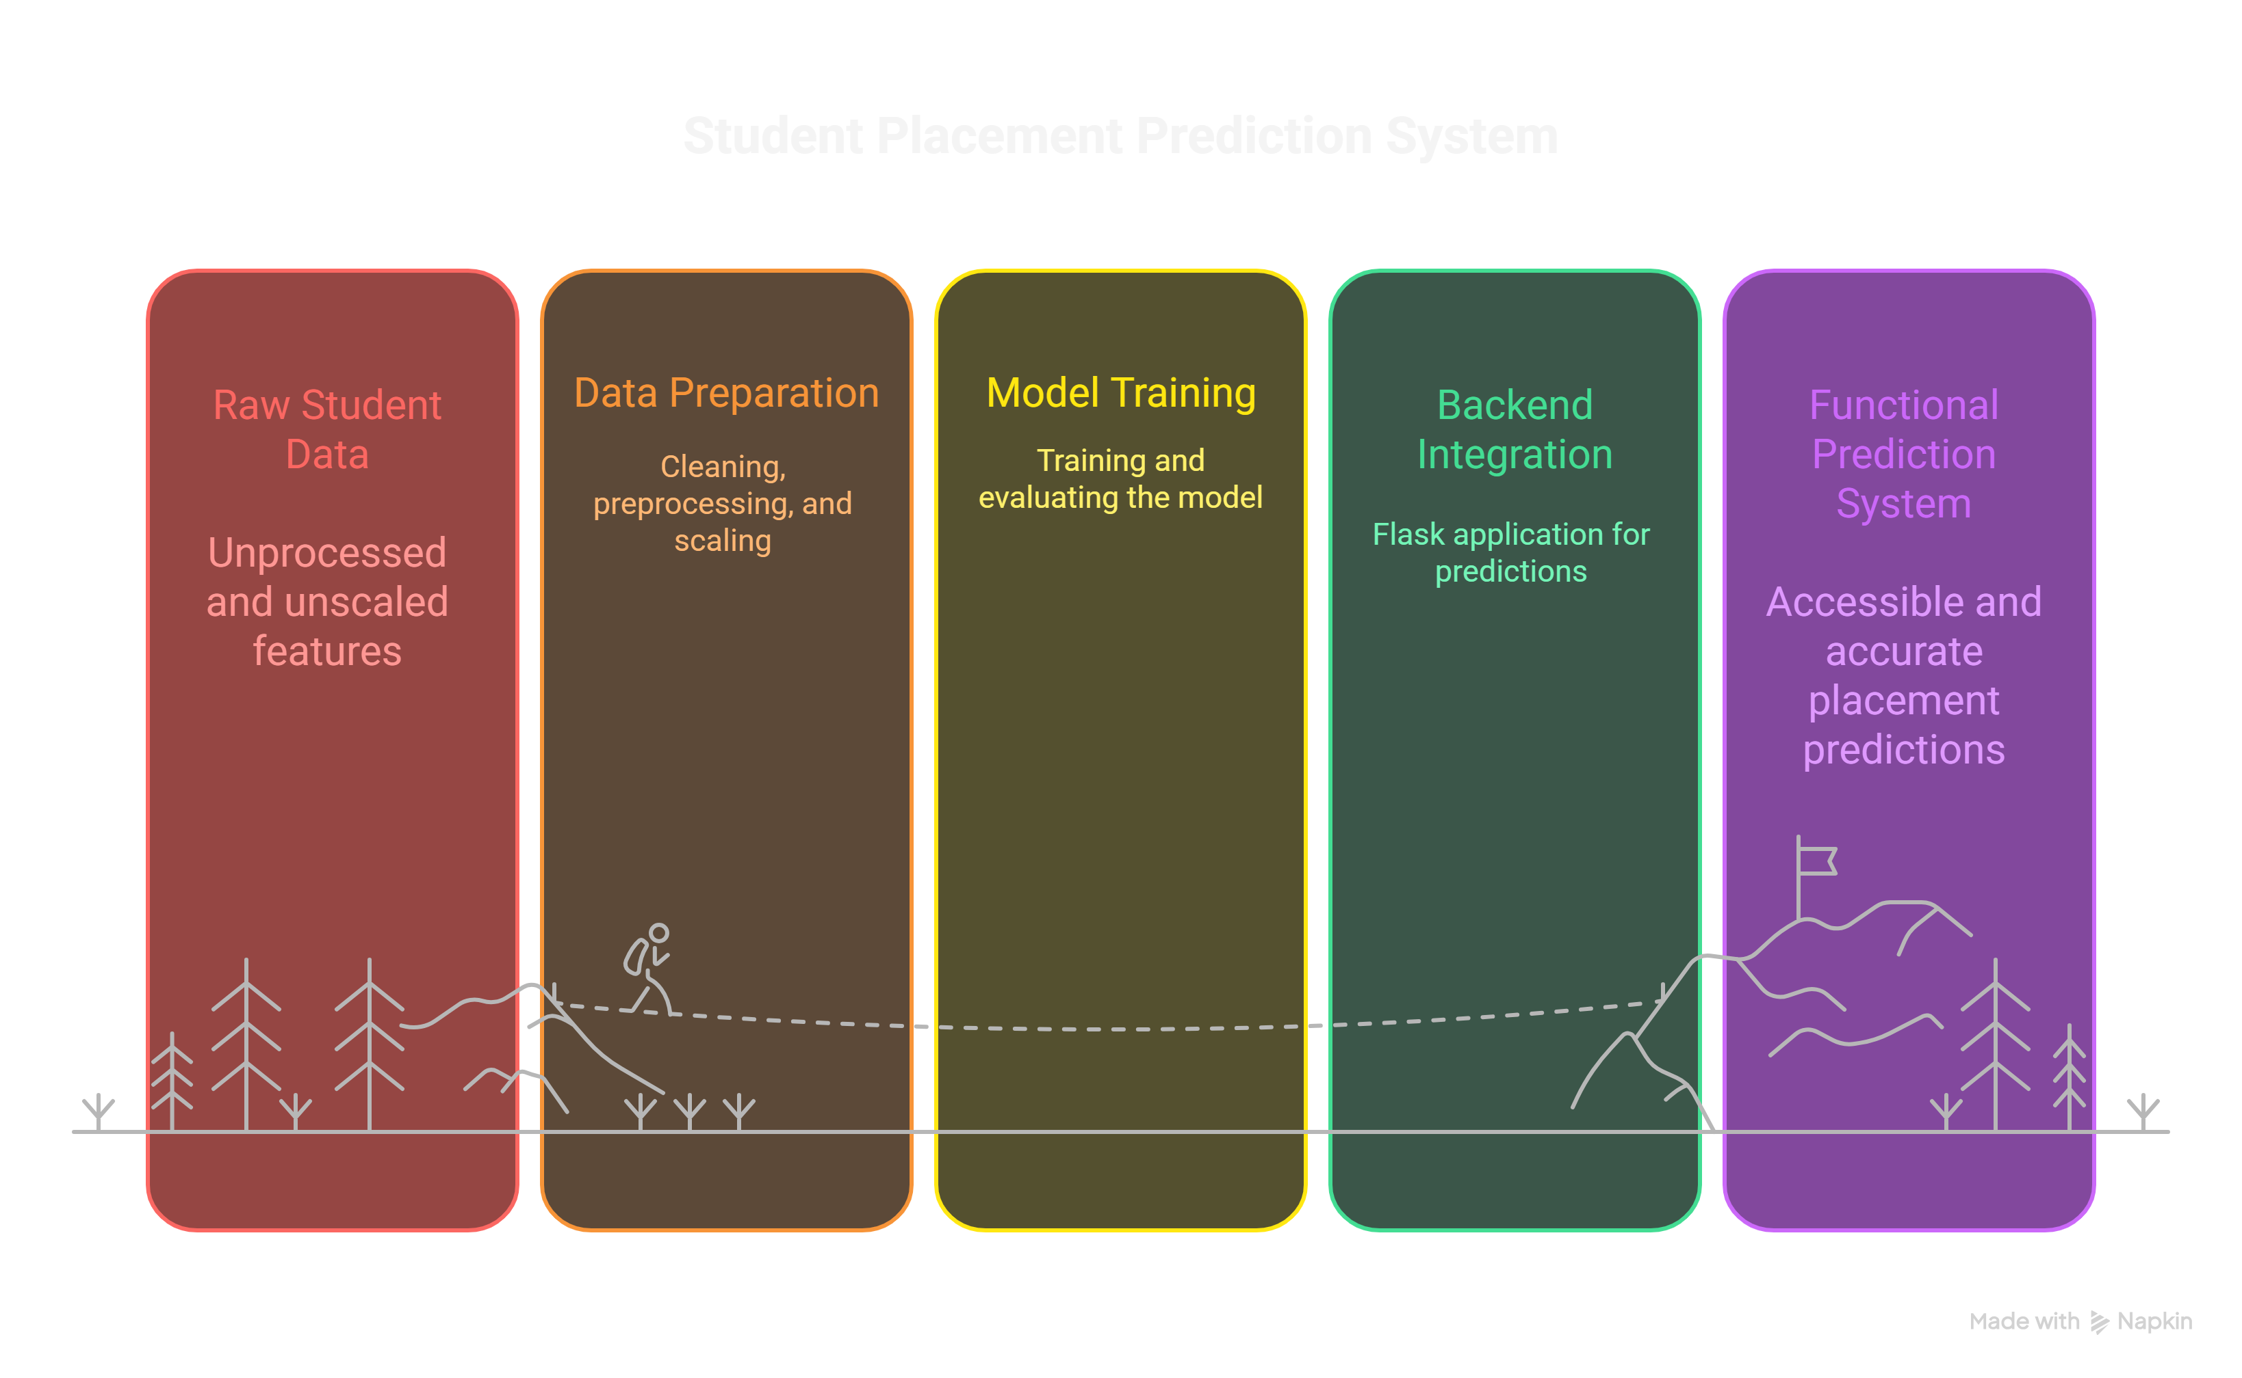

Slide 4
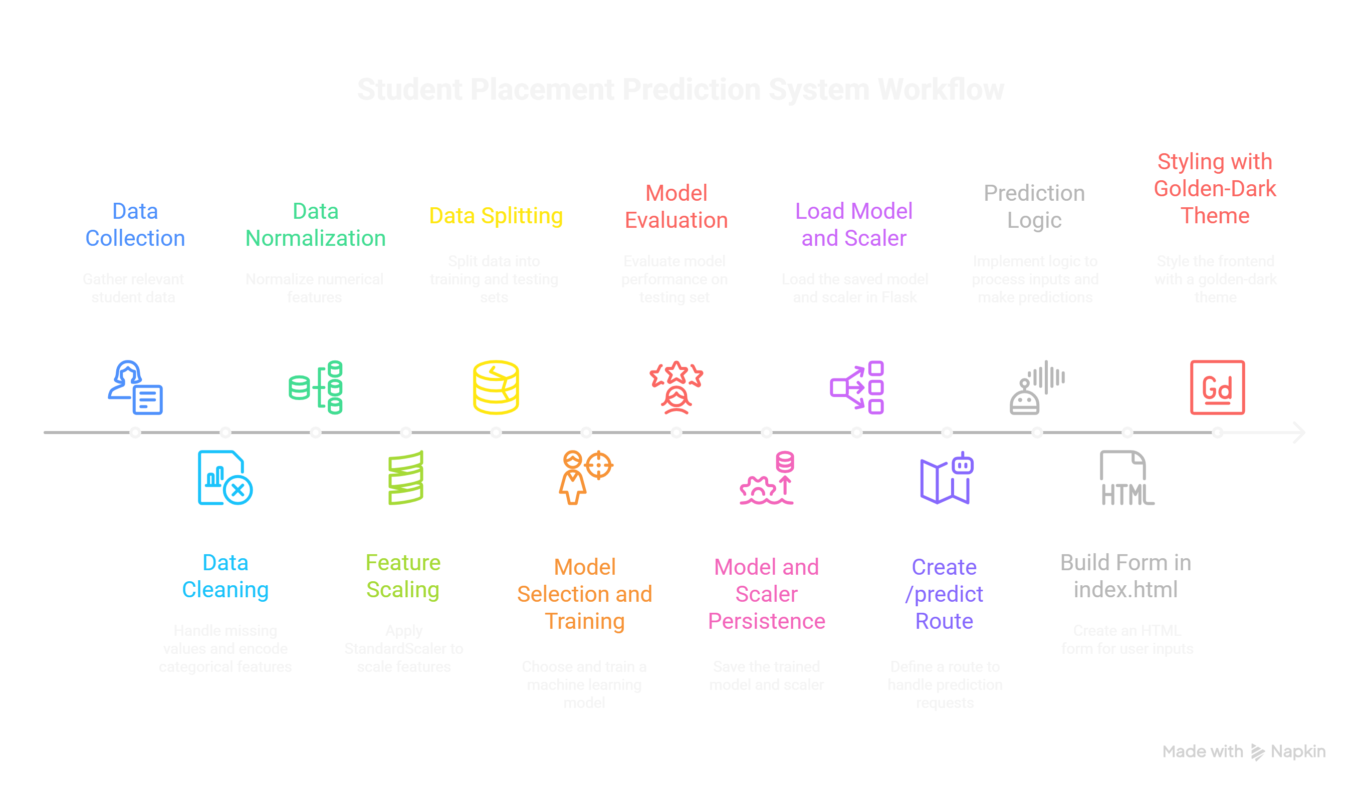

Slide 5
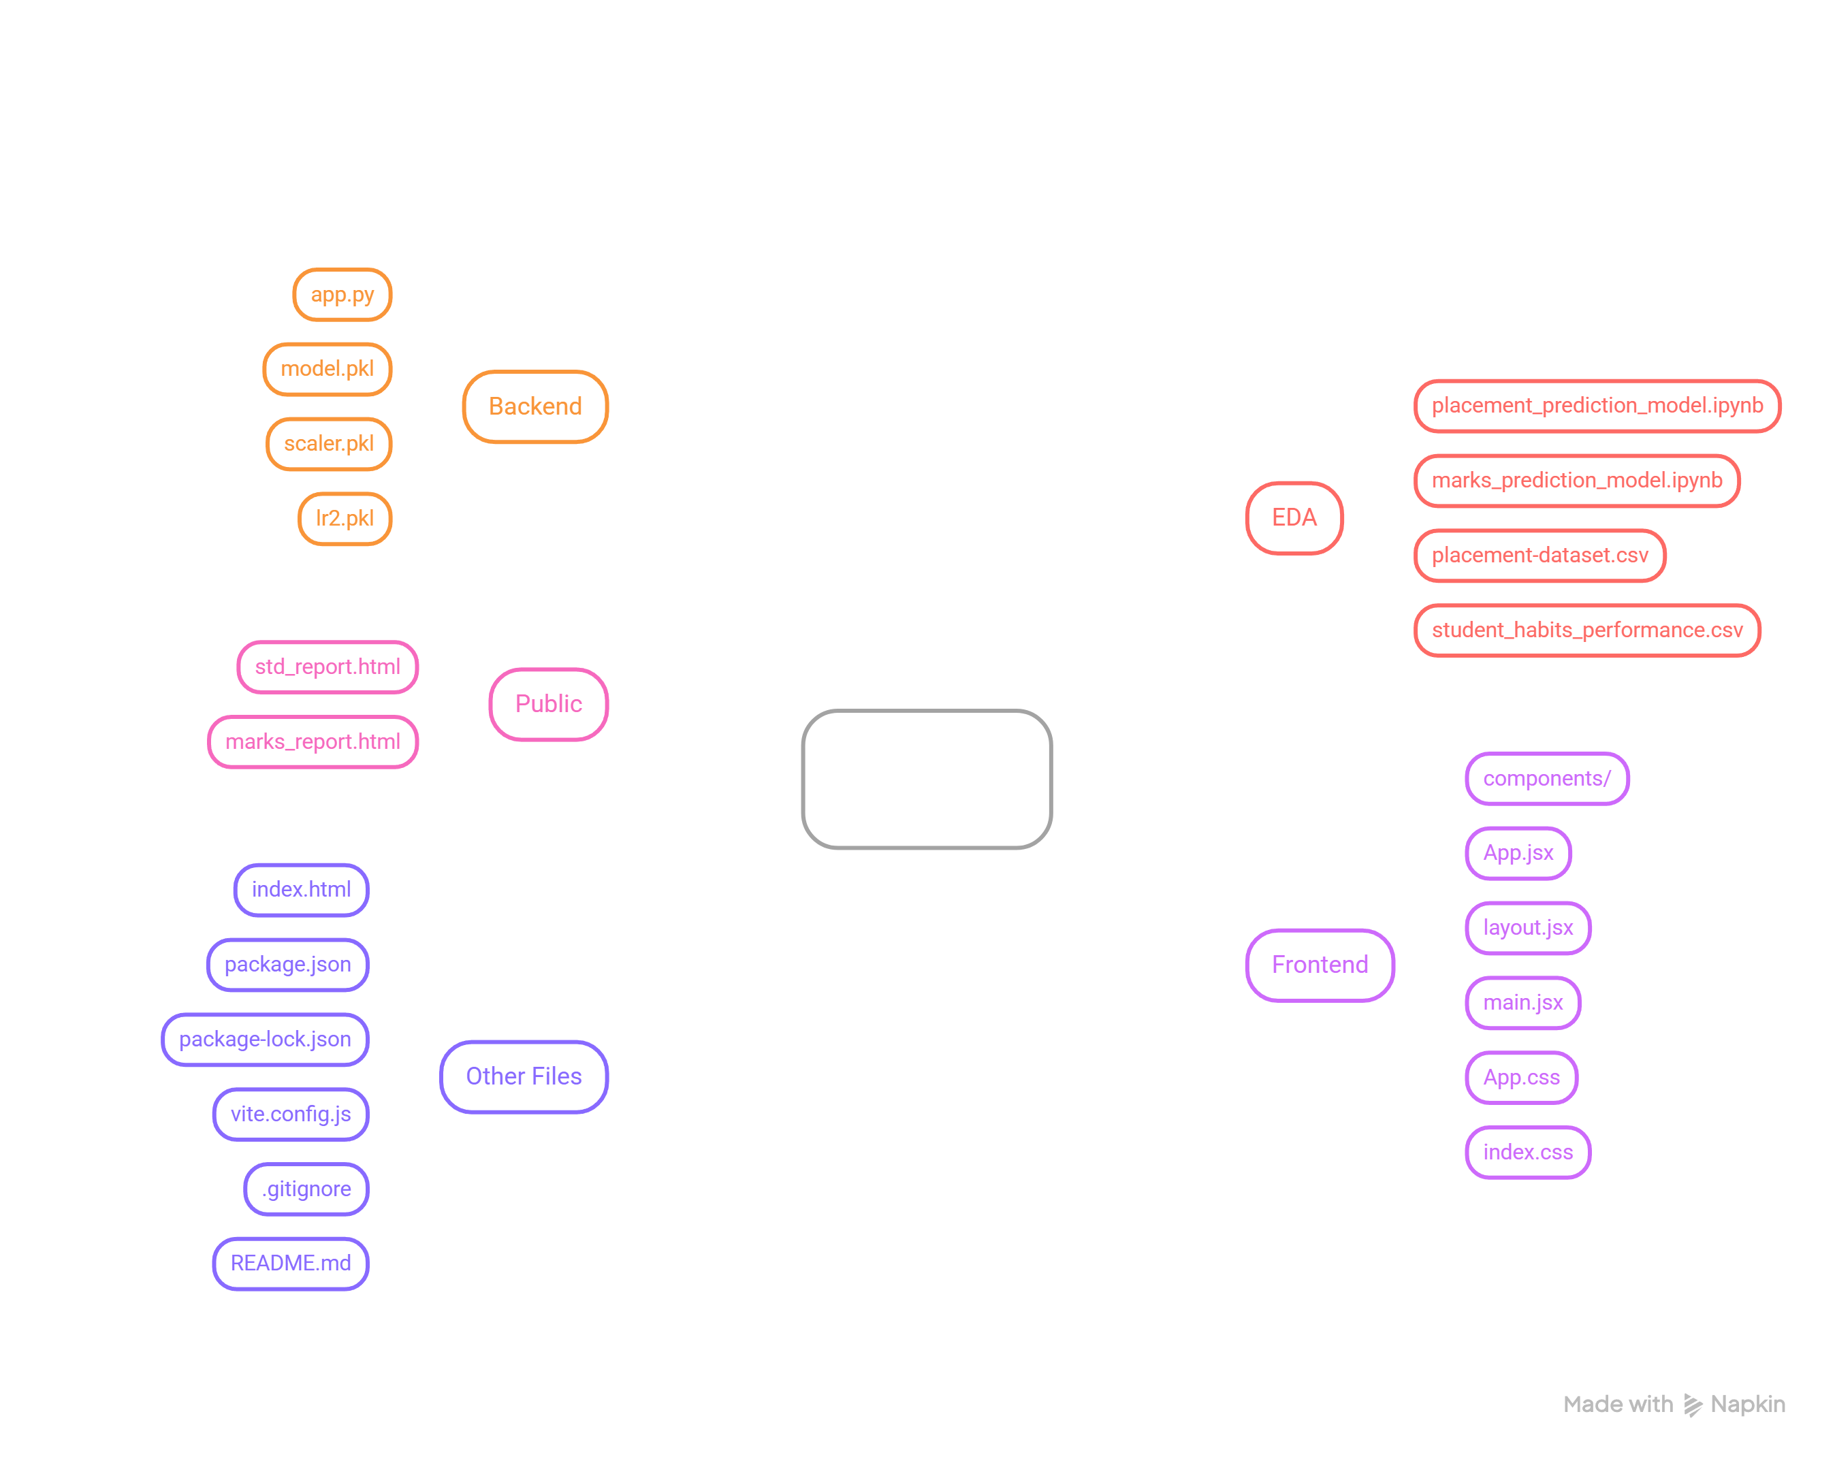

Slide 6
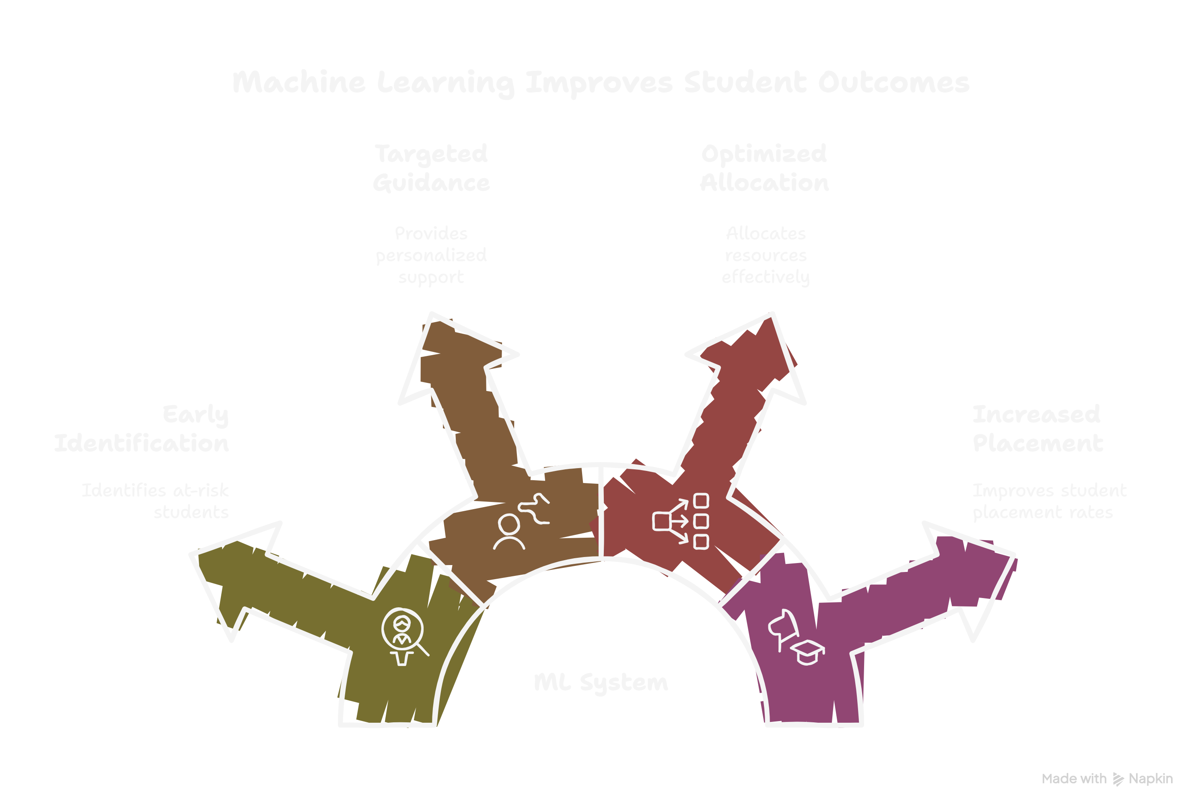

Slide 7
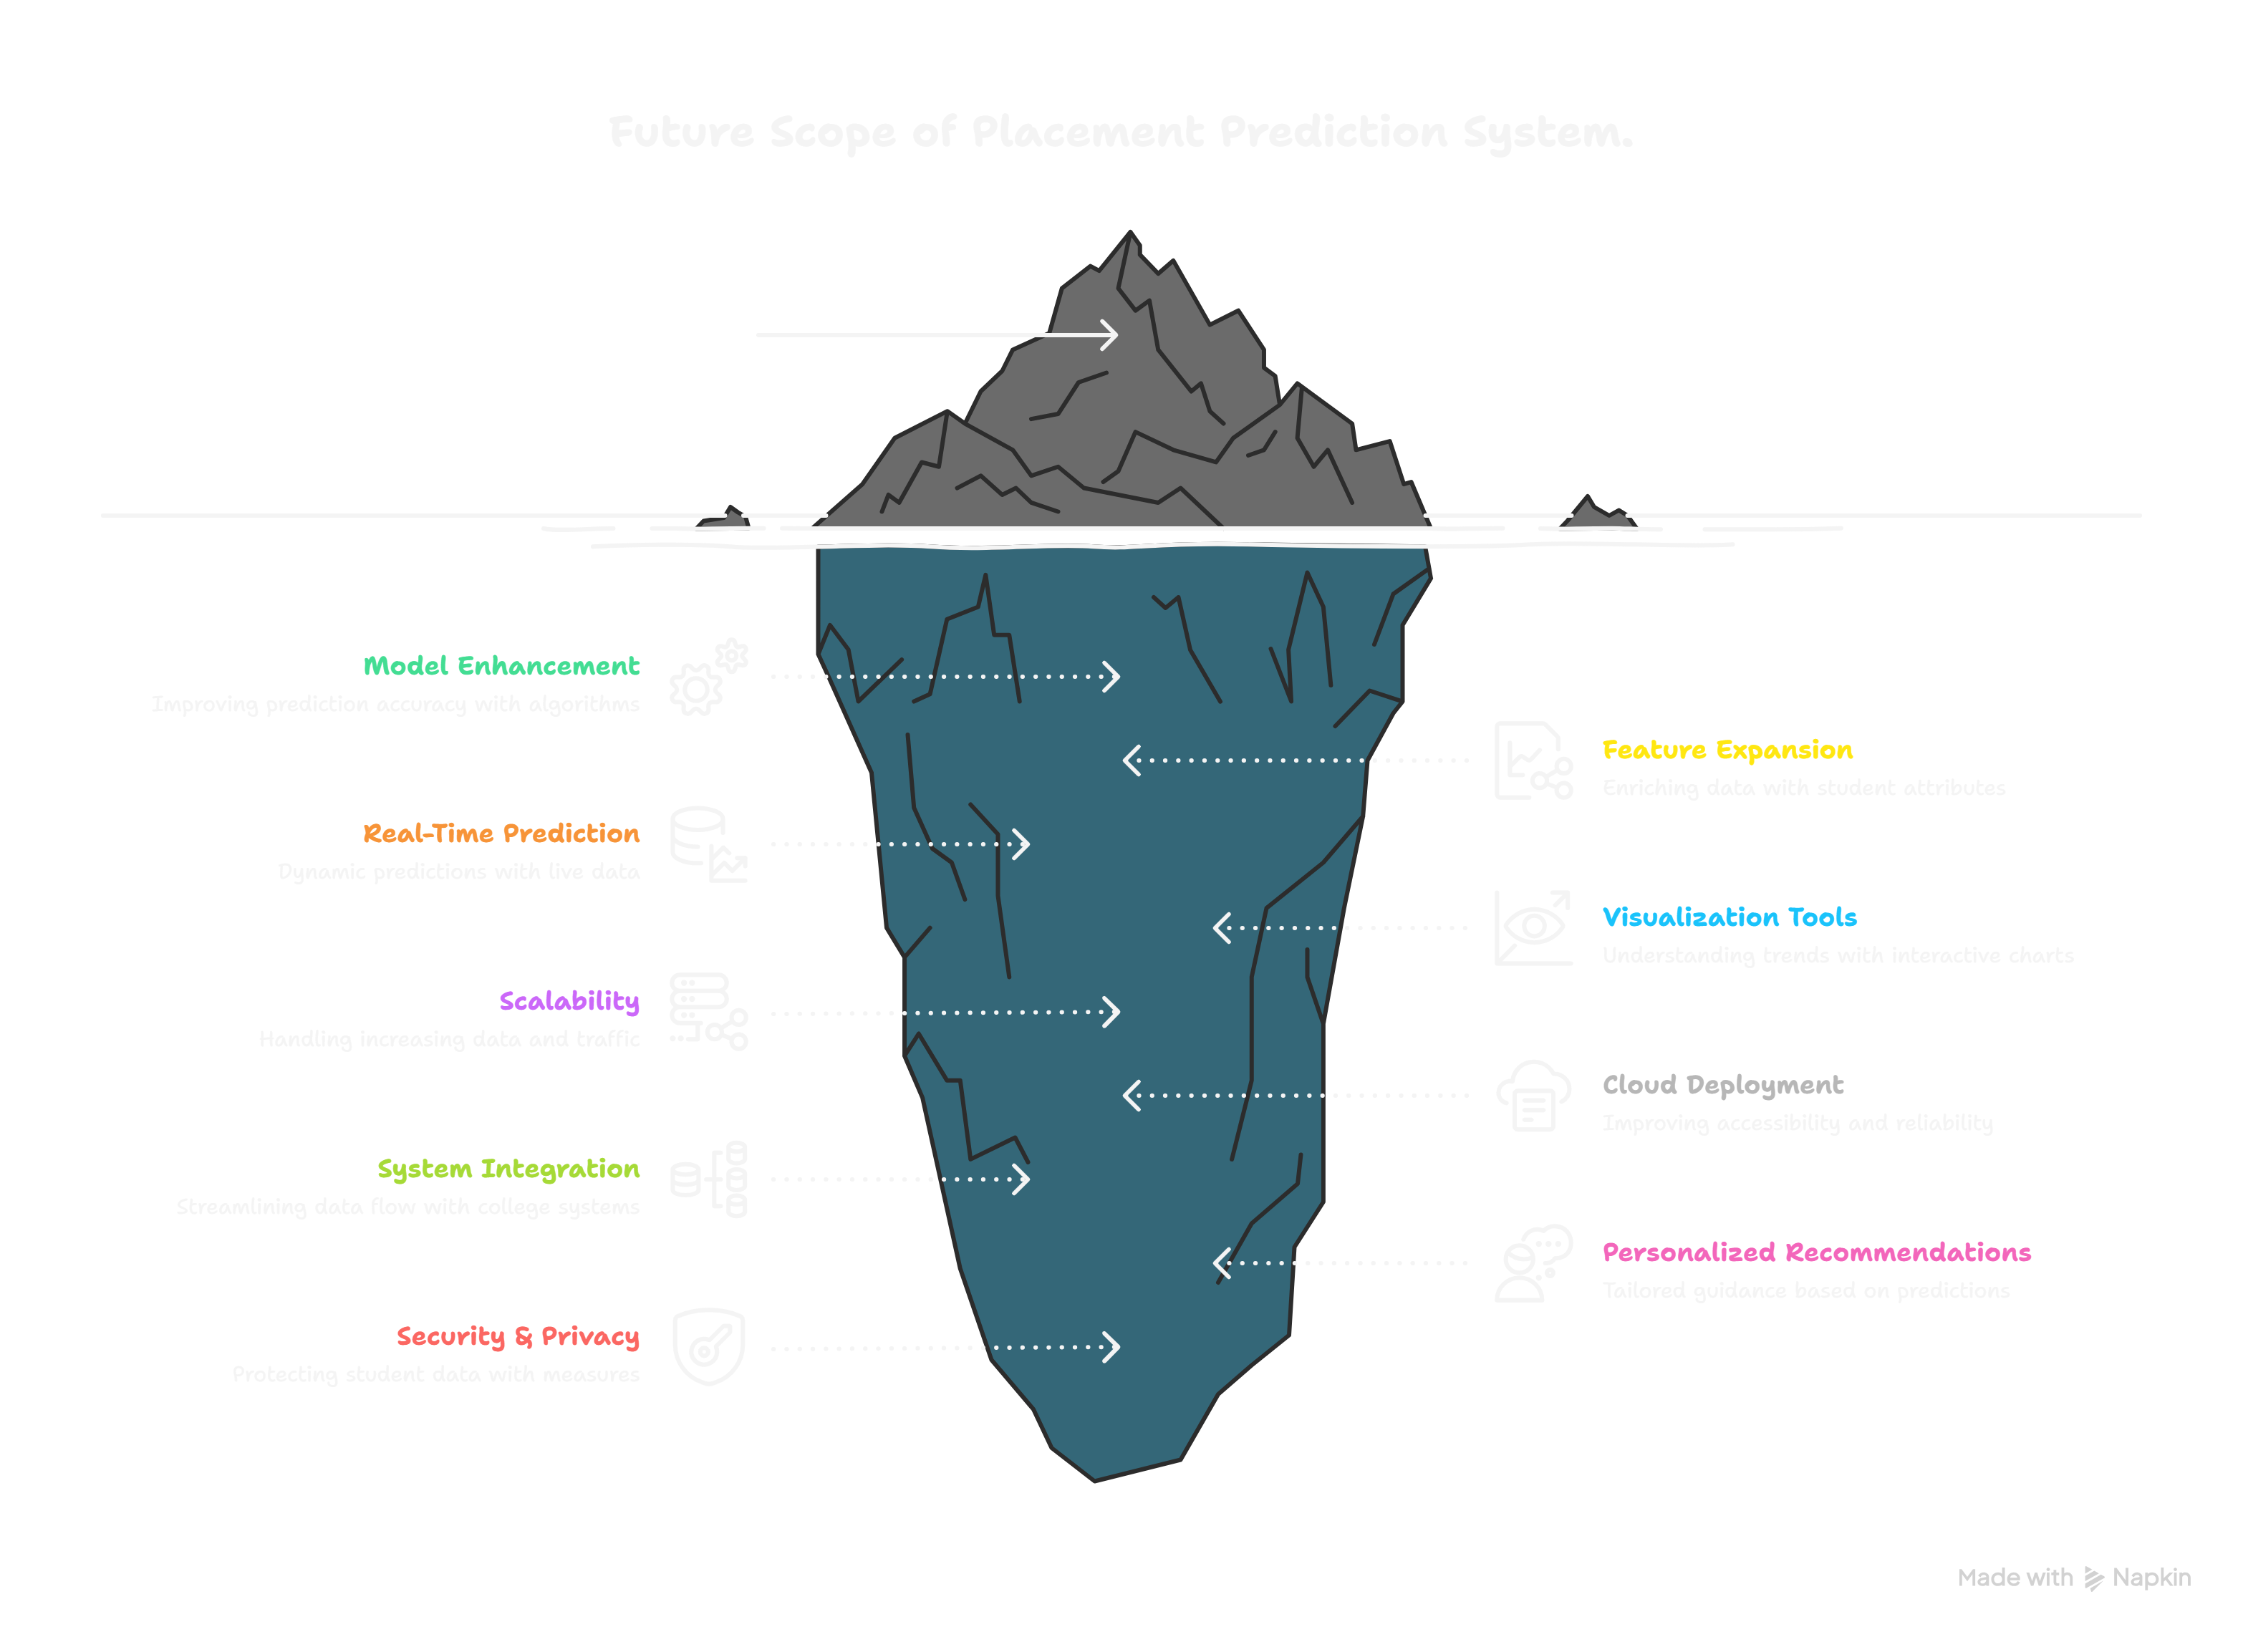

Slide 8
Thank you

